Slide 1
ICPT – Concepten in Programmeertalen
Les 2 – Lexicale, Syntactische en Semantische analyse

Slide 2
Topics lesson 2
Introduction
Lexical Analysis
The General Problem of Describing Syntax
Formal Methods of Describing Syntax
Attribute Grammars
Describing the Meanings of Programs: Dynamic Semantics

Slide 3
Introduction
Lexical: refers to things concerning the words of a language.
Syntax: the form or structure of the expressions, statements, and program units
Semantics: the meaning of the expressions, statements, and program units

Slide 4
Voorbeeld
Onze collega Marie is goed bevallen.

Slide 5
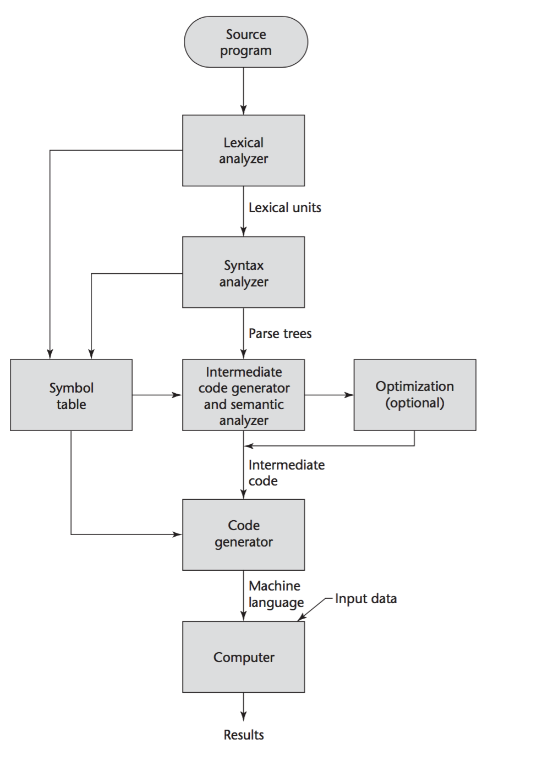
Compilation

Slide 6
Lexical analysis
A lexical analyzer is a pattern matcher for character strings
A lexical analyzer is a “front-end” for the parser
Identifies substrings of the source program that belong together - lexemes
Lexemes match a character pattern, which is associated with a lexical category called a token
sum is a lexeme; its token may be IDENT

Slide 7
The General Problem of Describing Syntax: Terminology
A sentence is a string of characters over some alphabet
A language is a set of sentences
A lexeme is the lowest level syntactic unit of a language (e.g., *, sum, begin)
A token is a category of lexemes (e.g., identifier)

Slide 8
Example
sum = 3 + 2;
Lexeme | Token category
sum | Identifier
= | Assignment operator
3 | Integer literal
+ | Addition operator
2 | Integer literal
; | End of statement

Slide 9
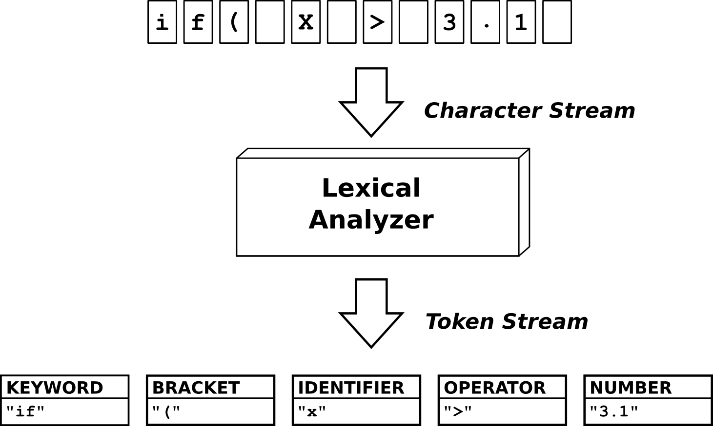
Voorbeeld - Lexicale analyse

Slide 10
Formal Definition of Languages
Recognizers
A recognition device reads input strings over the alphabet of the language and decides whether the input strings belong to the language
Example: syntax analysis part of a compiler
- Detailed discussion of syntax analysis appears in
Chapter 4
Generators
A device that generates sentences of a language
One can determine if the syntax of a particular sentence is syntactically correct by comparing it to the structure of the generator

Slide 11
BNF and Context-Free Grammars
Context-Free Grammars
Developed by Noam Chomsky in the mid-1950s
Language generators, meant to describe the syntax of natural languages
Define a class of languages called context-free languages
Backus-Naur Form (1959)
Invented by John Backus to describe the syntax of Algol 58
BNF is equivalent to context-free grammars

Slide 12
BNF Fundamentals
In BNF, abstractions are used to represent classes of syntactic structures--they act like syntactic variables (also called nonterminal symbols, or just terminals)
Terminals are lexemes or tokens
A rule has a left-hand side (LHS), which is a nonterminal, and a right-hand side (RHS), which is a string of terminals and/or nonterminals

Slide 13
BNF Fundamentals (continued)
Nonterminals are often enclosed in angle brackets
Examples of BNF rules:
<ident_list> → identifier | identifier, <ident_list>
<if_stmt> → if <logic_expr> then <stmt>
Grammar: a finite non-empty set of rules
A start symbol is a special element of the nonterminals of a grammar

Slide 14
BNF Rules
An abstraction (or nonterminal symbol) can have more than one RHS
<stmt> → <single_stmt>
| begin <stmt_list> end

Slide 15
Describing Lists
Syntactic lists are described using recursion
<ident_list> → ident
| ident, <ident_list>
A derivation is a repeated application of rules, starting with the start symbol and ending with a sentence (all terminal symbols)

Slide 16
An Example Grammar
<program> → <stmts>
<stmts> → <stmt> | <stmt> ; <stmts>
<stmt> → <var> = <expr>
<var> → a | b | c | d
<expr> → <term> + <term> | <term> - <term>
<term> → <var> | const

Slide 17
An Example Derivation
<program> => <stmts> => <stmt>
=> <var> = <expr>
=> a = <expr>
=> a = <term> + <term>
=> a = <var> + <term>
=> a = b + <term>
=> a = b + const

Slide 18
Derivations
Every string of symbols in a derivation is a sentential form
A sentence is a sentential form that has only terminal symbols
A leftmost derivation is one in which the leftmost nonterminal in each sentential form is the one that is expanded
A derivation may be neither leftmost nor rightmost

Slide 19
Maak een parse tree
Grammatica:
prog: (expr NEWLINE)* ;
expr: expr ('*'|'/') expr
| expr ('+'|'-') expr
| INT
| '(' expr ')'
;
NEWLINE : [\r\n]+ ;
INT : [0-9]+ ;
Code:
100+2*34

Slide 20
Parse Tree
A hierarchical representation of a derivation
<program>
<stmts>
<stmt>
<var>
=
<expr>
a
<term>
+
<term>
<var>
const
b

Slide 21
Rekensom
Wat is het resultaat van de onderstaande som met de onderstaande grammatica
Grammatica
<expr> → <expr> <op> <expr> | const
<op> → / | -
Som
9 - 3 / 3

Slide 22
Ambiguity in Grammars
A grammar is ambiguous if and only if it generates a sentential form that has two or more distinct parse trees

Slide 23
Resultaat
Twee mogelijkheden
9 - 3 / 3 = 9 – 1 = 8
9 - 3 / 3 = 6 / 3 = 2

Slide 24
An Ambiguous Expression Grammar
<expr> → <expr> <op> <expr> | const
<op> → / | -
<expr>
<expr>
<expr>
<op>
<expr>
<expr>
<op>
<op>
<expr>
<expr>
<op>
<expr>
<expr>
<op>
<expr>
const
-
const
/
const
const
-
const
/
const

Slide 25
An Unambiguous Expression Grammar
If we use the parse tree to indicate precedence levels of the operators, we cannot have ambiguity
<expr> → <expr> - <term> | <term>
<term> → <term> / const| const
<expr>
<expr>
-
<term>
<term>
<term>
/
const
const
const

Slide 26
Associativity of Operators
Operator associativity can also be indicated by a grammar
<expr> -> <expr> + <expr> | const (ambiguous)
<expr> -> <expr> + const | const (unambiguous)
<expr>
<expr>
<expr>
+
const
<expr>
+
const
const

Slide 27
Extended BNF
Optional parts are placed in brackets [ ]
<proc_call> -> ident [(<expr_list>)]
Alternative parts of RHSs are placed inside parentheses and separated via vertical bars
<term> → <term> (+|-) const
Repetitions (0 or more) are placed inside braces { }
<ident> → letter {letter|digit}

Slide 28
BNF and EBNF
BNF
<expr> → <expr> + <term>
| <expr> - <term>
| <term>
<term> → <term> * <factor>
| <term> / <factor>
| <factor>
EBNF
<expr> → <term> {(+ | -) <term>}
<term> → <factor> {(* | /) <factor>}

Slide 29
Recent Variations in EBNF
Alternative RHSs are put on separate lines
Use of a colon instead of =>
Use of _{opt} for optional parts
Use of oneof for choices

Slide 30
Semantics
There is no single widely acceptable notation or formalism for describing semantics
Several needs for a methodology and notation for semantics:
Programmers need to know what statements mean
Compiler writers must know exactly what language constructs do
Correctness proofs would be possible
Compiler generators would be possible
Designers could detect ambiguities and inconsistencies

Slide 31
Operational Semantics
Operational Semantics
Describe the meaning of a program by executing its statements on a machine, either simulated or actual. The change in the state of the machine (memory, registers, etc.) defines the meaning of the statement
To use operational semantics for a high-level language, a virtual machine is needed

Slide 32
Operational Semantics
A hardware pure interpreter would be too expensive
A software pure interpreter also has problems
The detailed characteristics of the particular computer would make actions difficult to understand
Such a semantic definition would be machine- dependent

Slide 33
Operational Semantics (continued)
A better alternative: A complete computer simulation
The process:
Build a translator (translates source code to the machine code of an idealized computer)
Build a simulator for the idealized computer
Evaluation of operational semantics:
Good if used informally (language manuals, etc.)
Extremely complex if used formally (e.g., VDL), it was used for describing semantics of PL/I.

Slide 34
Operational Semantics (continued)
Uses of operational semantics:
- Language manuals and textbooks
- Teaching programming languages
Two different levels of uses of operational semantics:
- Natural operational semantics
- Structural operational semantics
Evaluation
- Good if used informally (language
manuals, etc.)
- Extremely complex if used formally (e.g.,VDL)

Slide 35
Denotational Semantics
Based on recursive function theory
The most abstract semantics description method
Originally developed by Scott and Strachey (1970)

Slide 36
Denotational Semantics - continued
The process of building a denotational specification for a language:
- Define a mathematical object for each language
entity
Define a function that maps instances of the language entities onto instances of the corresponding mathematical objects
The meaning of language constructs are defined by only the values of the program's variables

Slide 37
Denotational Semantics: program state
The state of a program is the values of all its current variables
s = {<i₁, v₁>, <i₂, v₂>, …, <i_{n}, v_{n}>}
Let VARMAP be a function that, when given a variable name and a state, returns the current value of the variable
VARMAP(i_{j}, s) = v_{j}

Slide 38
Decimal Numbers
<dec_num> → '0' | '1' | '2' | '3' | '4' | '5' |
'6' | '7' | '8' | '9' |
<dec_num> ('0' | '1' | '2' | '3' |
'4' | '5' | '6' | '7' |
'8' | '9')
M_{dec}('0') = 0, M_{dec} ('1') = 1, …, M_{dec} ('9') = 9
M_{dec} (<dec_num> '0') = 10 * M_{dec} (<dec_num>)
M_{dec} (<dec_num> '1’) = 10 * M_{dec} (<dec_num>) + 1
…
M_{dec} (<dec_num> '9') = 10 * M_{dec} (<dec_num>) + 9

Slide 39
Expressions
Map expressions onto Z ∪ {error}
We assume expressions are decimal numbers, variables, or binary expressions having one arithmetic operator and two operands, each of which can be an expression

Slide 40
Expressions
M_{e}(<expr>, s) Δ=
case <expr> of
<dec_num> => M_{dec}(<dec_num>, s)
<var> =>
if VARMAP(<var>, s) == undef
then error
else VARMAP(<var>, s)
<binary_expr> =>
if (M_{e}(<binary_expr>.<left_expr>, s) == undef
OR M_{e}(<binary_expr>.<right_expr>, s) =
undef)
then error
else
if (<binary_expr>.<operator> == '+' then
M_{e}(<binary_expr>.<left_expr>, s) +
M_{e}(<binary_expr>.<right_expr>, s)
else M_{e}(<binary_expr>.<left_expr>, s) *
M_{e}(<binary_expr>.<right_expr>, s)
...

Slide 41
Assignment Statements
Maps state sets to state sets U {error}
M_{a}(x := E, s) Δ=
if M_{e}(E, s) == error
then error
else s’ = {<i₁,v₁’>,<i₂,v₂’>,...,<i_{n},v_{n}’>},
where for j = 1, 2, ..., n,
if i_{j} == x
then v_{j}’ = M_{e}(E, s)
else v_{j}’ = VARMAP(i_{j}, s)

Slide 42
Logical Pretest Loops
Maps state sets to state sets U {error}
M_{l}(while B do L, s) Δ=
if M_{b}(B, s) == undef
then error
else if M_{b}(B, s) == false
then s
else if M_{sl}(L, s) == error
then error
else M_{l}(while B do L, M_{sl}(L, s))

Slide 43
Loop Meaning
The meaning of the loop is the value of the program variables after the statements in the loop have been executed the prescribed number of times, assuming there have been no errors
In essence, the loop has been converted from iteration to recursion, where the recursive control is mathematically defined by other recursive state mapping functions
- Recursion, when compared to iteration, is easier
to describe with mathematical rigor

Slide 44
Evaluation of Denotational Semantics
Can be used to prove the correctness of programs
Provides a rigorous way to think about programs
Can be an aid to language design
Has been used in compiler generation systems
Because of its complexity, it are of little use to language users

Slide 45
Axiomatic Semantics
Based on formal logic (predicate calculus)
Original purpose: formal program verification
Axioms or inference rules are defined for each statement type in the language (to allow transformations of logic expressions into more formal logic expressions)
The logic expressions are called assertions

Slide 46
Axiomatic Semantics (continued)
An assertion before a statement (a precondition) states the relationships and constraints among variables that are true at that point in execution
An assertion following a statement is a postcondition
A weakest precondition is the least restrictive precondition that will guarantee the postcondition

Slide 47
Axiomatic Semantics Form
Pre-, post form: {P} statement {Q}
An example
a = b + 1 {a > 1}
One possible precondition: {b > 10}
Weakest precondition: {b > 0}

Slide 48
Program Proof Process
The postcondition for the entire program is the desired result
Work back through the program to the first statement. If the precondition on the first statement is the same as the program specification, the program is correct.

Slide 49
Summary
BNF and context-free grammars are equivalent meta-languages
Well-suited for describing the syntax of programming languages
An attribute grammar is a descriptive formalism that can describe both the syntax and the semantics of a language
Three primary methods of semantics description
Operation, axiomatic, denotational

